Slide 1


Slide 2
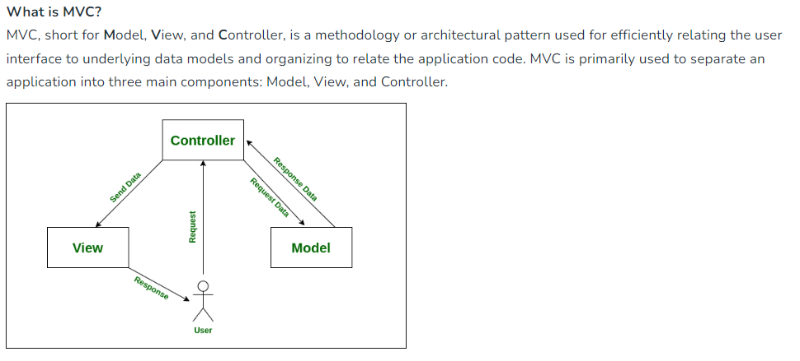
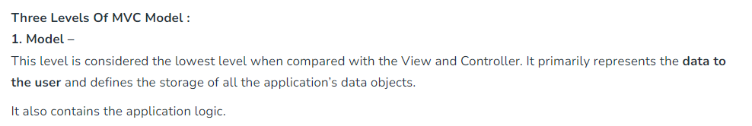
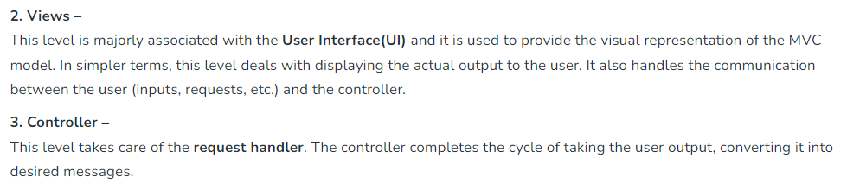
MVC

Slide 3
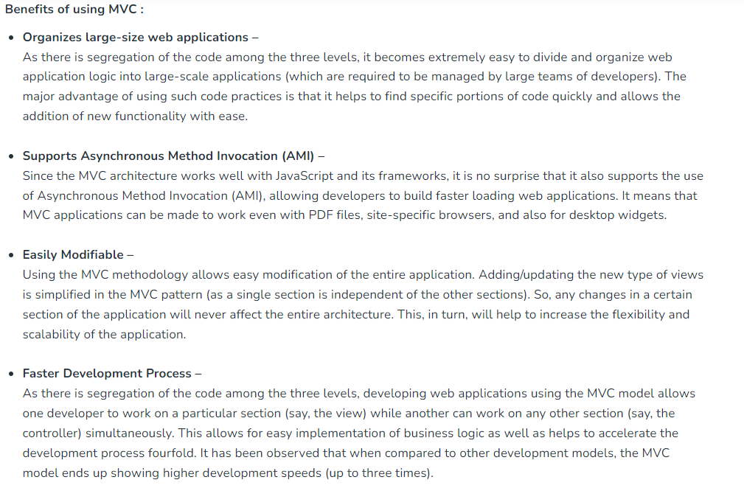
MVC

Slide 4
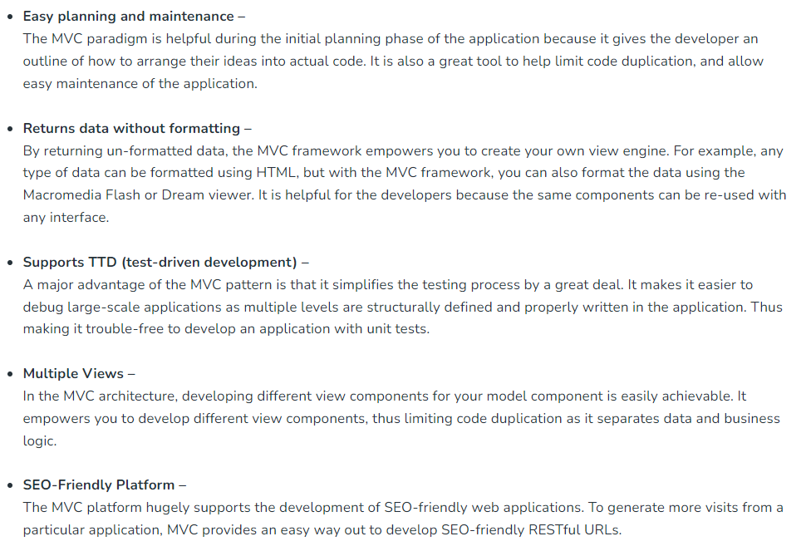
MVC

Slide 5
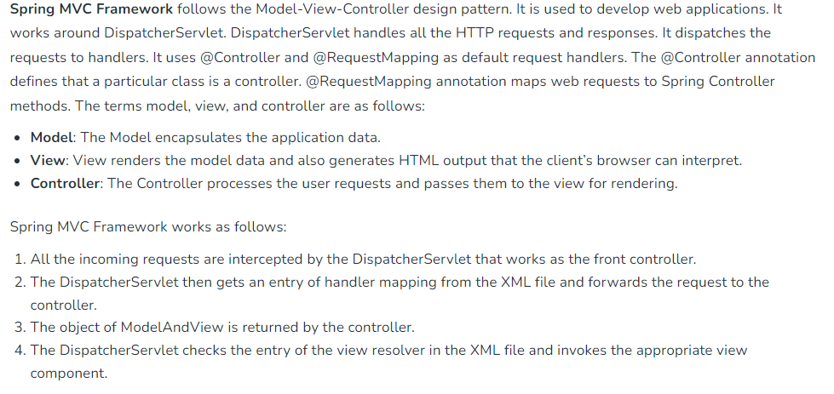
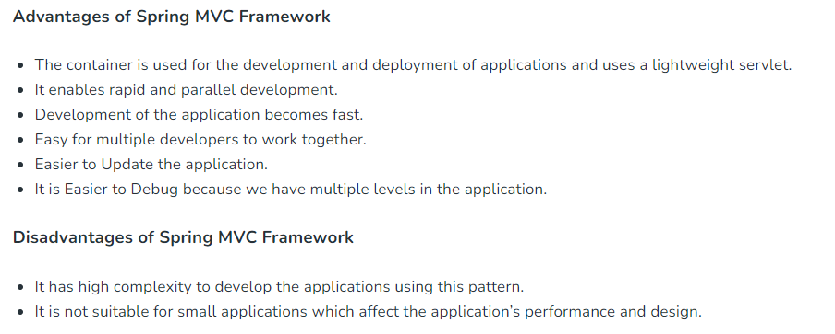
Spring Framework

Slide 6
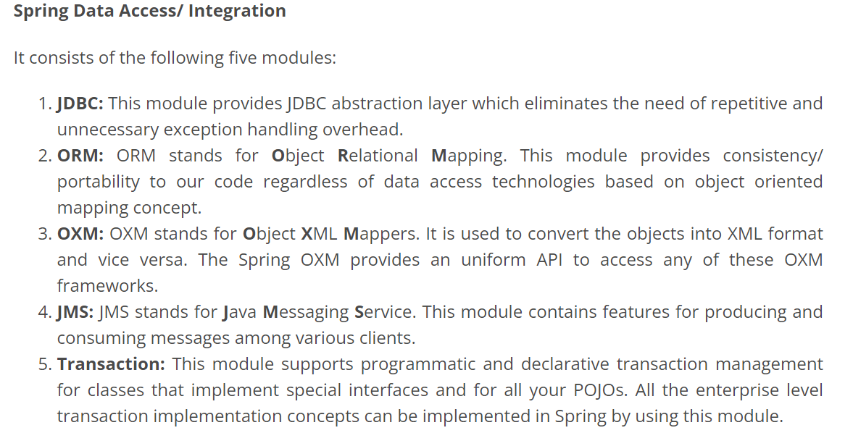
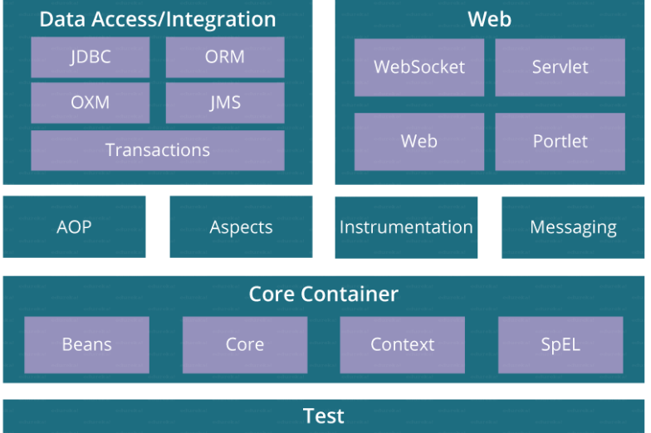
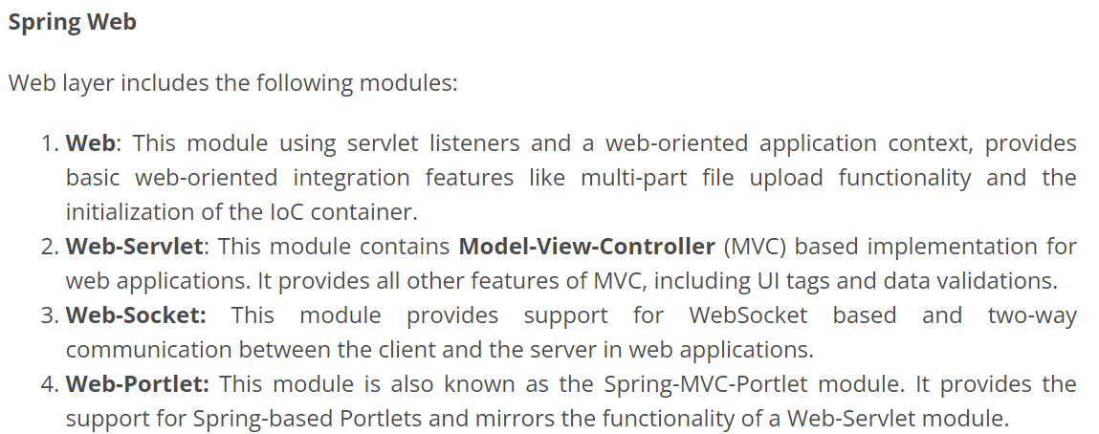
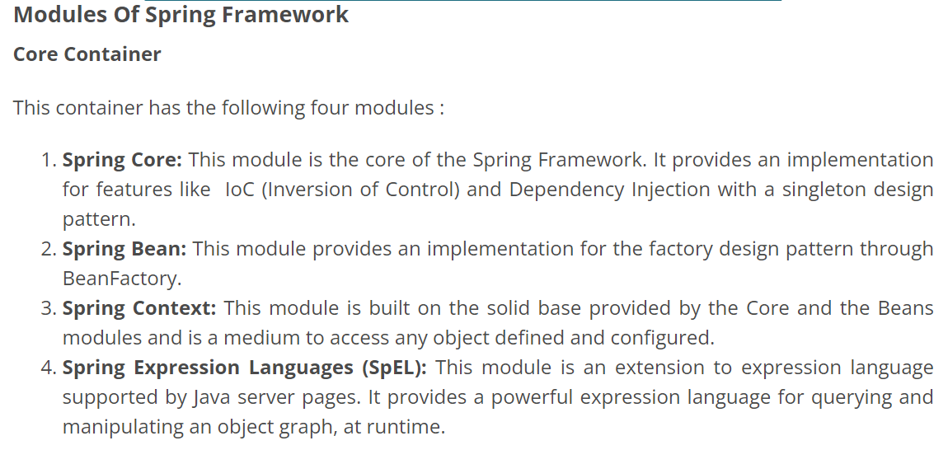
Spring Framework - Architecture

Slide 7
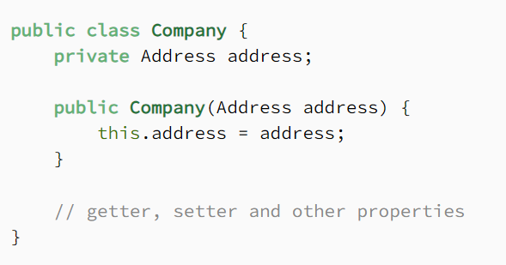

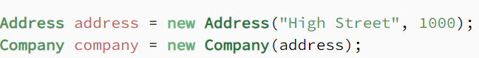
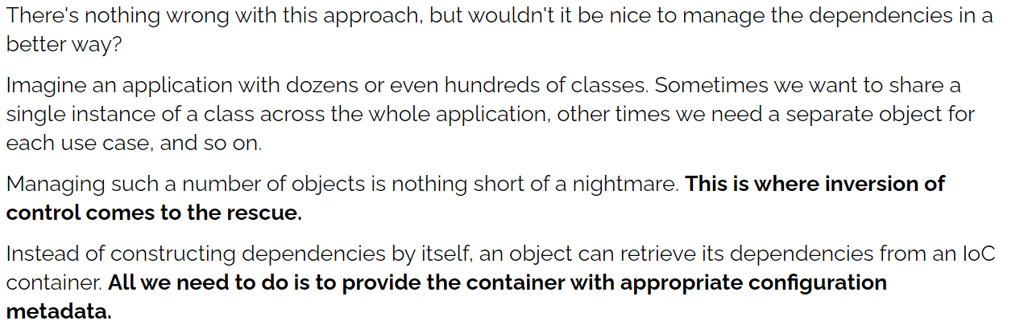
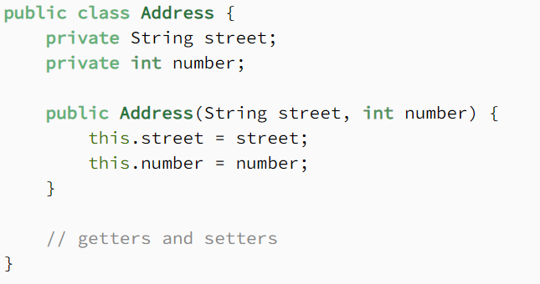
Spring IoC (Inversion of Control)

Slide 8
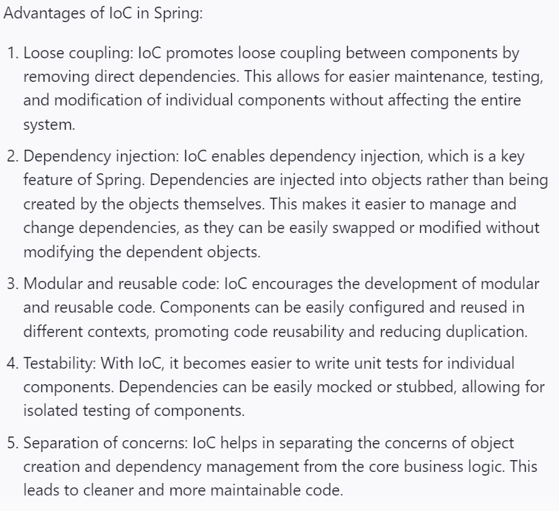
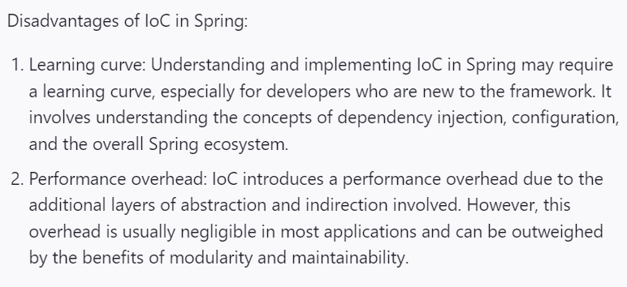
Spring IoC (Inversion of Control)

Slide 9
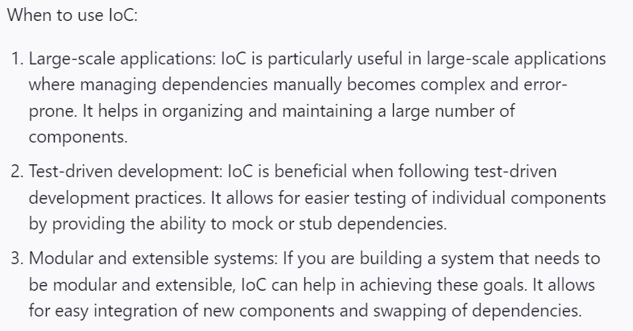
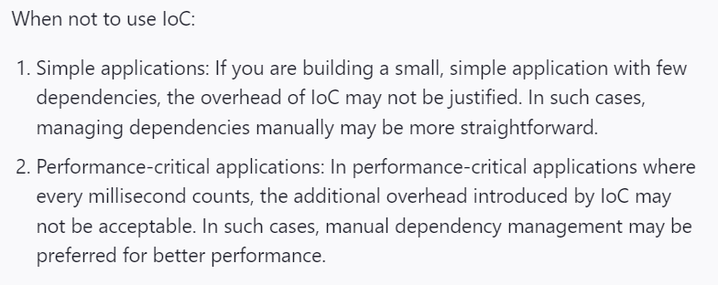
Spring IoC (Inversion of Control)

Slide 10
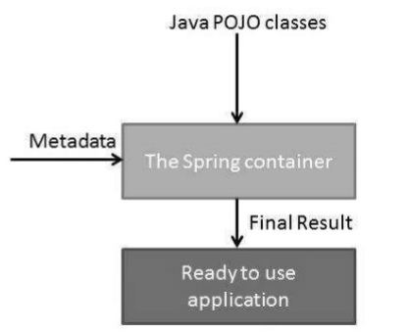
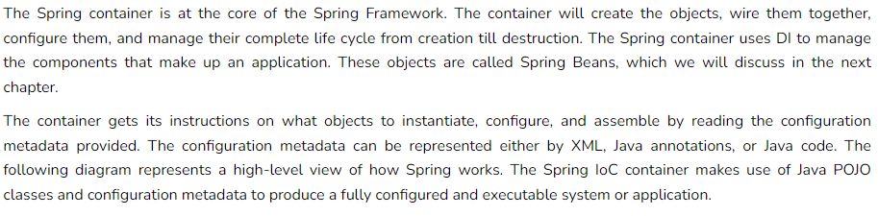
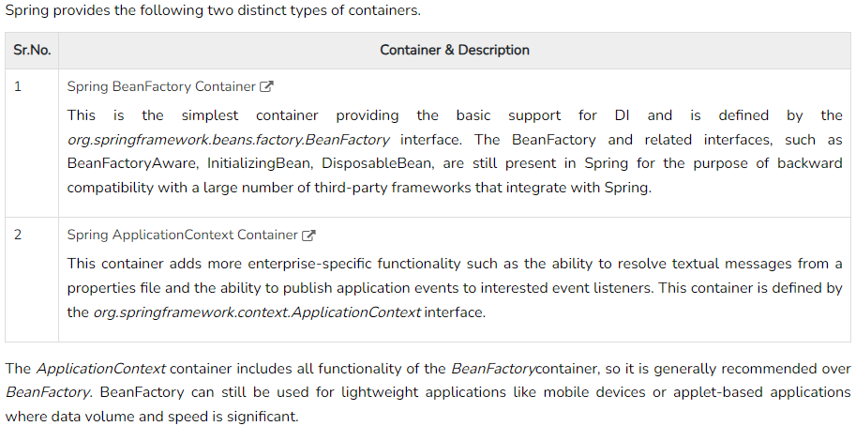
Spring IoC (Inversion of Control) Container

Slide 11
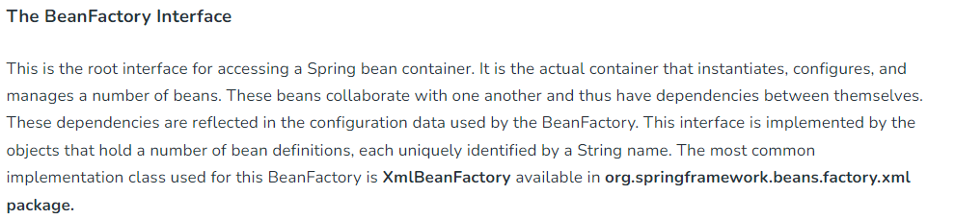
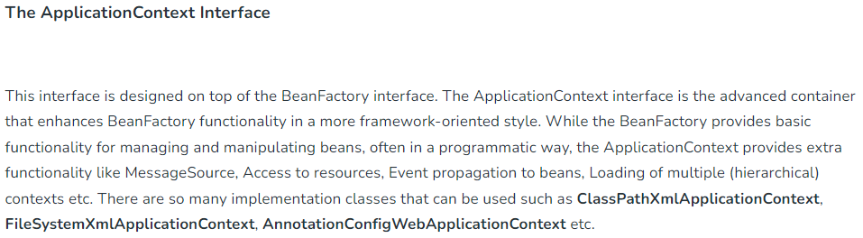
Spring IoC (Inversion of Control) Container

Slide 12
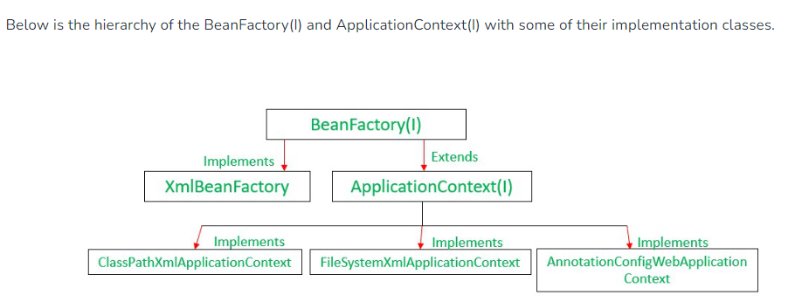
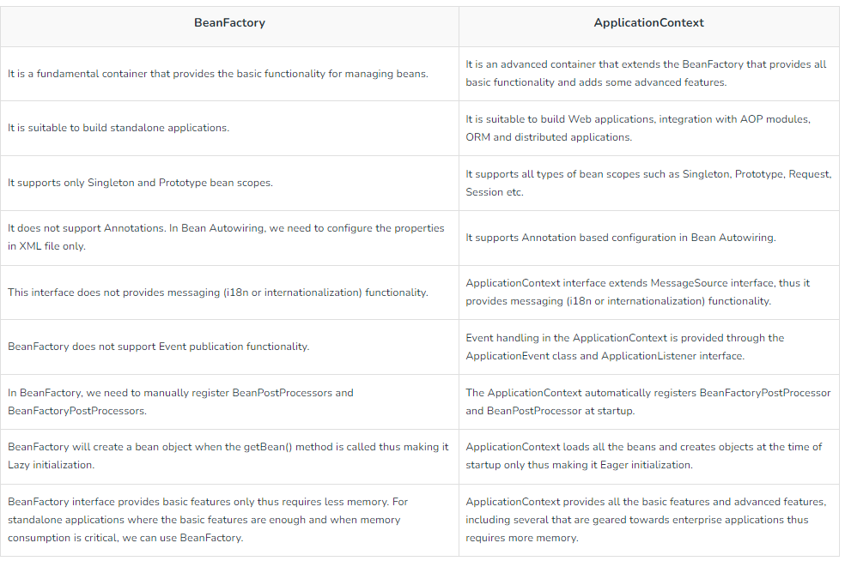
Spring IoC (Inversion of Control) Container

Slide 13
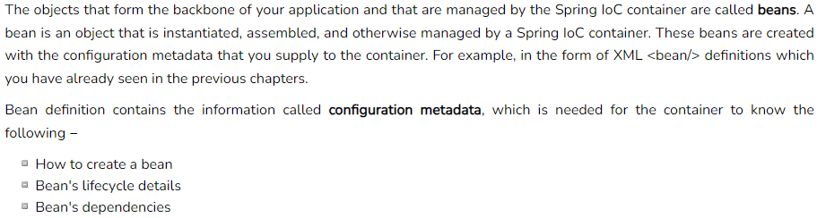
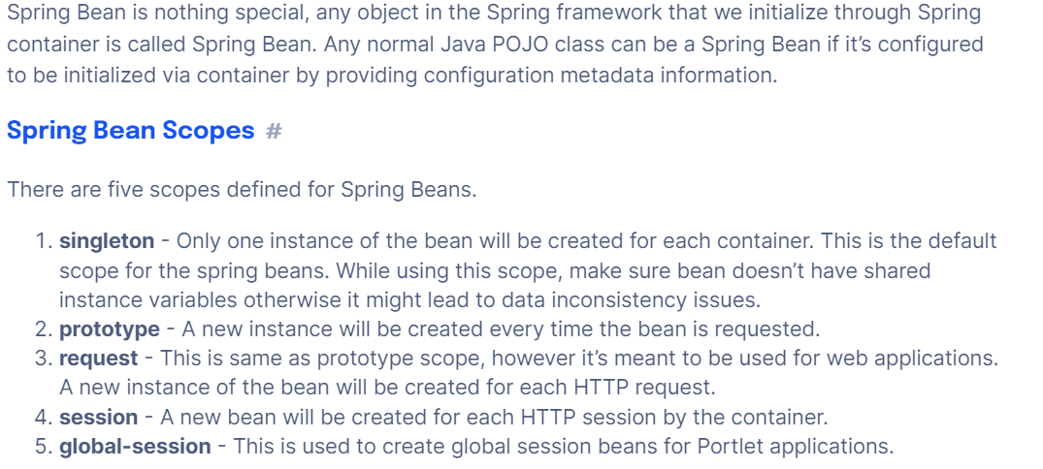
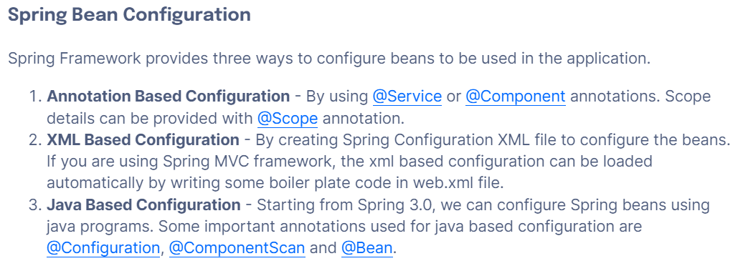
Spring Bean

Slide 14
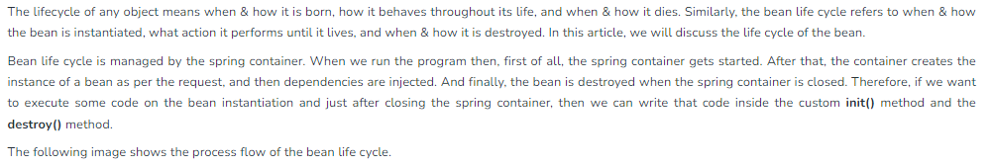
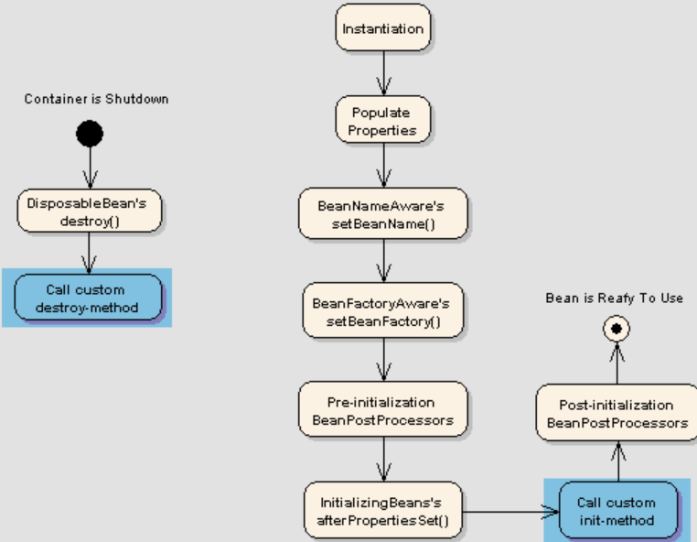
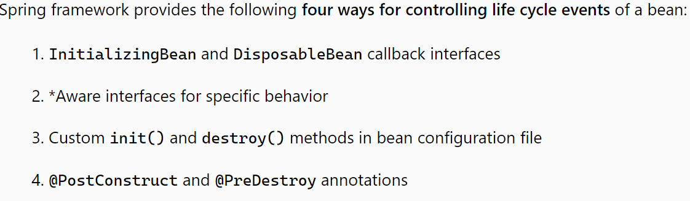
Spring Bean Life cycle

Slide 15
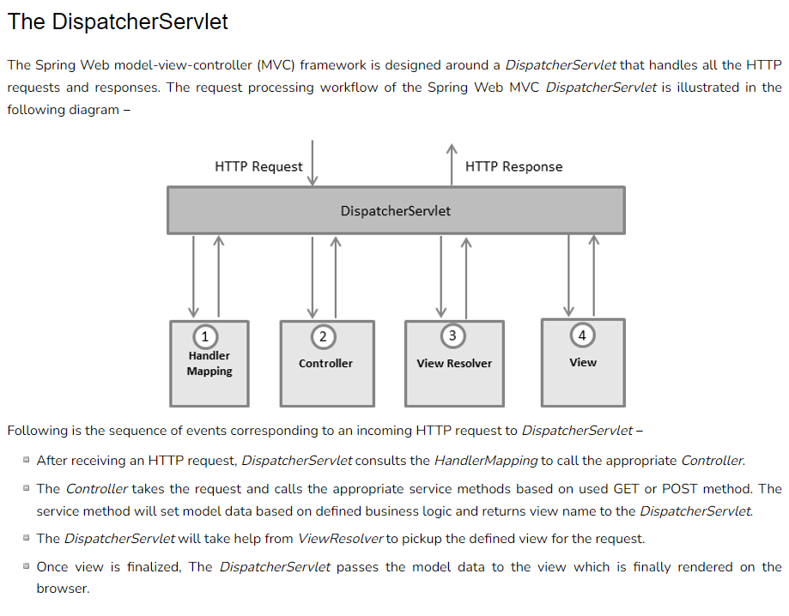
Spring Framework

Slide 16
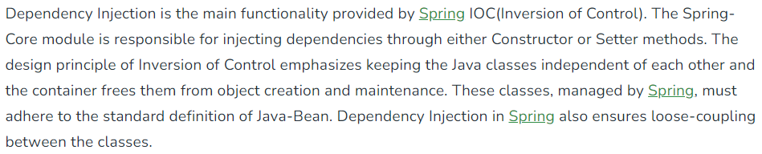
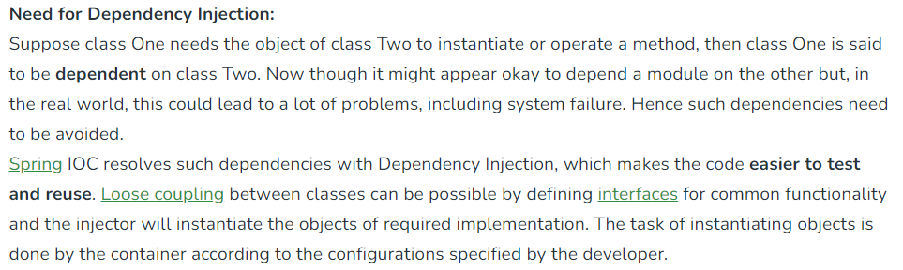
Spring Framework – Dependency Injection

Slide 17
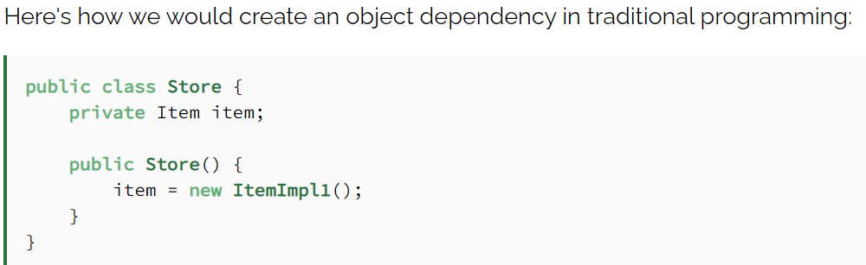
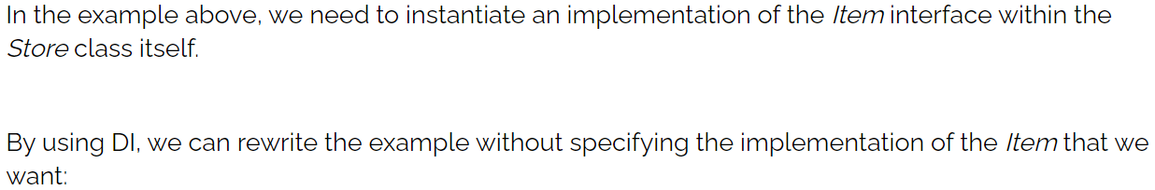
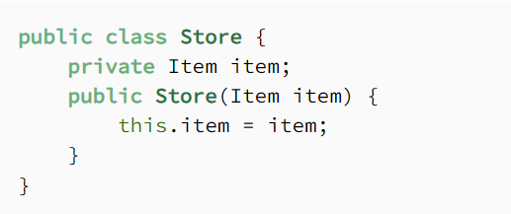
Spring Framework – Dependency Injection

Slide 18
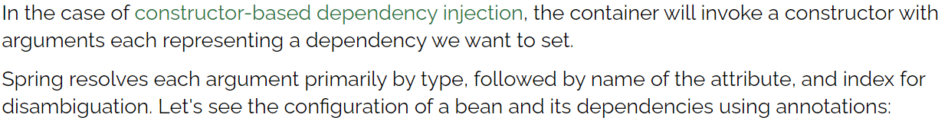
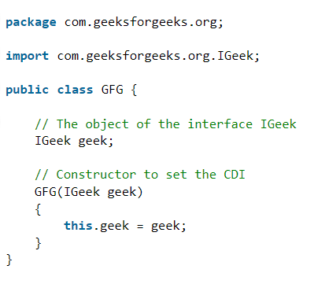
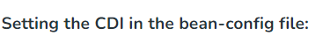
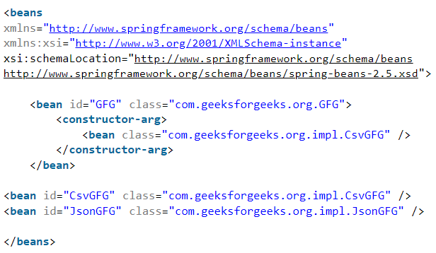
Spring Framework – Dependency Injection

Slide 19
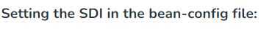
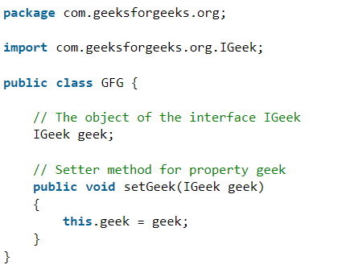
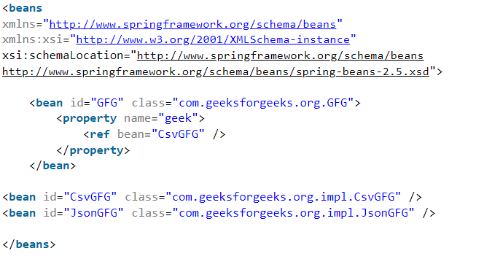
Spring Framework – Dependency Injection
In this, the DI will be injected with the help of setter and/or getter methods. Now to set the DI as SDI in the bean, it is done through the bean-configuration file For this, the property to be set with the SDI is declared under the <property> tag in the bean-config file.
For setter-based DI, the container will call setter methods of our class after invoking a no-argument constructor or no-argument static factory method to instantiate the bean.

Slide 20
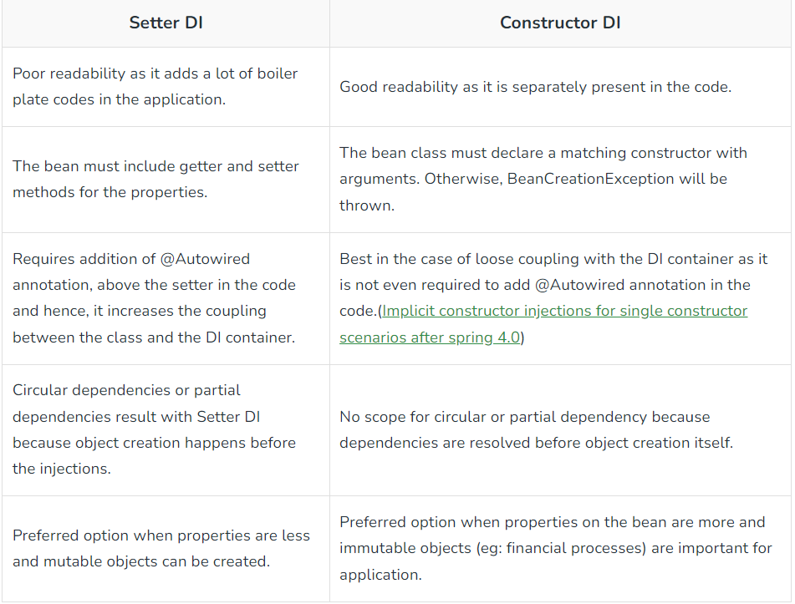
Spring Framework – Dependency Injection

Slide 21
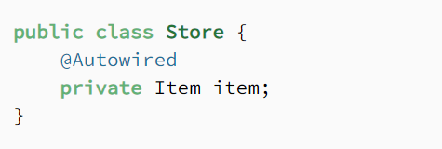
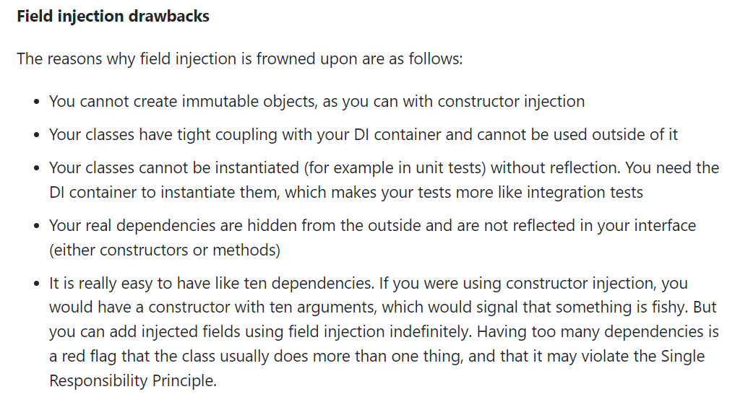
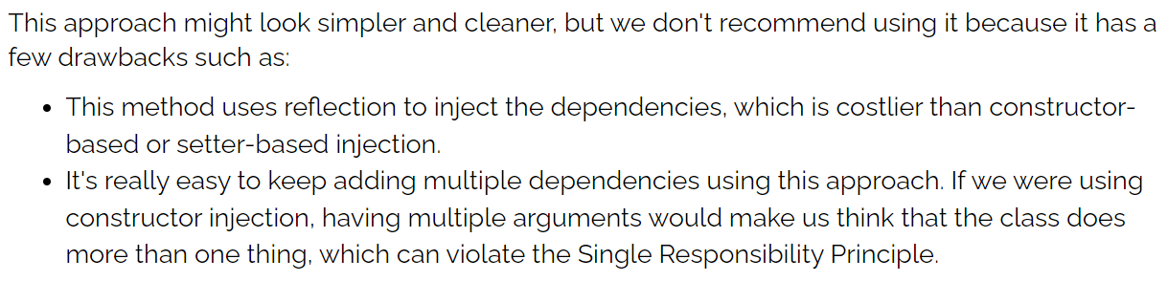
Spring Framework – Dependency Injection

Slide 22
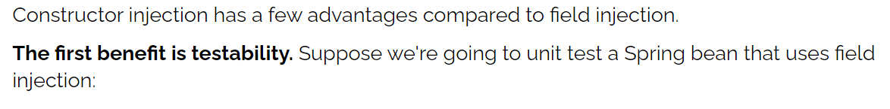


Spring Framework – Dependency Injection

Slide 23






Spring Framework – Autowiring Dependencies

Slide 24



Spring Framework – Autowiring Dependencies

Slide 25









Spring Framework – Autowiring Dependencies

Slide 26


Spring Framework – Autowiring Dependencies

Slide 27



Maven

Slide 28


Maven

Slide 29



Maven

Slide 30


Maven

Slide 31

AOP(Aspect Oriented Programming)

Slide 32



AOP(Aspect Oriented Programming)

Slide 33


Spring – Important Annotations

Slide 34
Spring – Important Annotations

Slide 35

Spring – Important Annotations

Slide 36




REST (Representational State Transfer)

Slide 37


REST (Representational State Transfer)

Slide 38


REST (Representational State Transfer)

Slide 39



REST (Representational State Transfer)

Slide 40

REST (Representational State Transfer)

Slide 41

REST (Representational State Transfer)

Slide 42



REST vs SOAP

Slide 43


REST vs SOAP

Slide 44

REST vs SOAP

Slide 45




JSON (JavaScript Object Notation)

Slide 46



JSON (JavaScript Object Notation)

Slide 47




JSON (JavaScript Object Notation)

Slide 48


JSON (JavaScript Object Notation)

Slide 49


Spring Boot

Slide 50




Spring Boot

Slide 51




Spring Boot

Slide 52




Spring Boot

Slide 53




Spring Boot

Slide 54


Spring Boot

Slide 55



Spring Boot

Slide 56


Spring Boot

Slide 57


Spring Boot

Slide 58



JUnit

Slide 59


JUnit

Slide 60





Mockito

Slide 61


ORM(Object Relational Mapping)

Slide 62


ORM(Object Relational Mapping)

Slide 63



ORM(Object Relational Mapping)

Slide 64



JPA(Java Persistence API) vs Hibernate

Slide 65


JPA(Java Persistence API) vs Hibernate

Slide 66






Spring Data JPA

Slide 67




Spring Data JPA

Slide 68



Spring Data JPA

Slide 69



Spring Data JPA

Slide 70



Spring Data JPA

Slide 71






Security
Spring Security can be used to secure REST APIs. REST APIs are stateless. Thus, they shouldn't use sessions or cookies. Instead, these should be secure using Basic authentication, API Keys, JWT, or OAuth2-based tokens.

Slide 72





Security

Slide 73



Security

Slide 74




Security

Slide 75


Security

Slide 76



Spring Boot - Exceptional Handling
Exceptions thrown by a Controller method is mapped to the ControllerAdvice method using @ExceptionHandler annotations

Slide 77


Micro Services

Slide 78


Micro Services

Slide 79


Micro Services

Slide 80



Micro Services

Slide 81

Micro Services

Slide 82




Micro Services – Application Gateway

Slide 83


Micro Services – Service Discovery

Slide 84


Micro Services – Service Discovery

Slide 85

Micro Services – Service Discovery

Slide 86





Micro Services – Ribbon Client Side Load Balancer

Slide 87


Micro Services – Ribbon Client Side Load Balancer

Slide 88




Micro Services – Ribbon Client Side Load Balancer

Slide 89


Micro Services – Ribbon Client Side Load Balancer

Slide 90


Micro Services – Feign Client
FeignClient is a Declarative REST Client in Spring Boot Web Application. Declarative REST Client means you just give the client specification as an Interface and spring boot takes care of the implementation for you. FeignClient is used to consume RESTFul API endpoints exposed by third-party or microservice

Slide 91

Micro Services – Feign Client

Slide 92

Micro Services – Feign Client
When two web applications communicate with each other for data exchange, they work on Producer-Consumer technique. An application who produces data is known as a Producer/Provider application. Similarly, the one who consumes data is known as Consumer application.
As a Java developer, we might be very familiar with REST API for Producer application whereas RestTemplate for Consumer application. With Microservices based application also, two Microservices communicate with each other and follow the Producer-Consumer model.
Here, in consumer side, we use a concept ‘Feign Client’ as a better option instead of RestTemplate to minimize our effort of coding.
Apart from consuming REST services in an easy way, FeignClient/OpenFeign when combined with Eureka also offers us an easy load balancing

Slide 93




Micro Services – Feign Client vs Rest Template

Slide 94



Micro Services – Distributed Tracing

Slide 95

Micro Services – Distributed Tracing
Purpose of Distributed Tracing:

Slide 96



Micro Services – Distributed Tracing

Slide 97



Micro Services – Distributed Tracing

Slide 98



Micro Services – Distributed Tracing

Slide 99



Micro Services – Distributed Tracing

Slide 100



Micro Services – Distributed Tracing

Slide 101



Micro Services – Fault Tolerance

Slide 102



Micro Services – Fault Tolerance with Hystrix

Slide 103


Micro Services – Fault Tolerance with Hystrix
Microservices based applications feature a huge number of distributed components. These components interact with each other during the request processing. As the number of interactions over the network increases, the possibility of an abnormal behavior of a service may also increase. In that case, we need to have some handy techniques that can prevent or minimize this abnormal behavior. Here, we are talking about none other than a fault-tolerance mechanism.

Slide 104




Micro Services – Fault Tolerance with Hystrix

